Slide 1
Program Name: Introduction to service mesh with istio and Kiali
Date: 05/12/2023
EMPOWERING High Performance Technology Teams

Slide 2
Microservices
Decomposing an application into single function modules which are independently deployed and operated
Accelerate delivery by minimizing communication and coordination between people

Slide 3
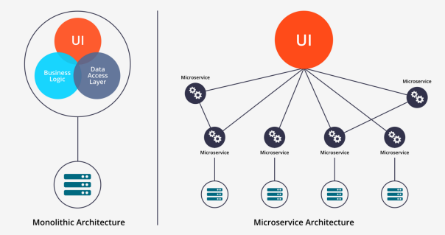
Architecture

Slide 4
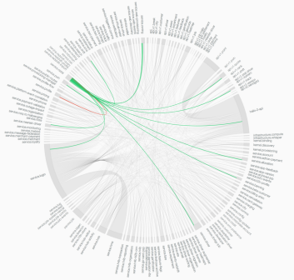
The Trade Off
Improved delivery velocity in exchange for
increased operational complexity
Hail microservices

Slide 5
Microservices Are Hard
Applications aren’t running in green-field environments
Network layer is hard to manage
Tooling is nascent (Just coming to existence)

Slide 6
Things To Consider
Security

Slide 7
Things To Consider
Security
Canary deployments

Slide 8
Things To Consider
Security
Canary deployments
A/B testing

Slide 9
Things To Consider
Security
Canary deployments
A/B testing
Circuit breaking

Slide 10
Things To Consider
Security
Canary deployments
A/B testing
Circuit breaking
Rate limiting

Slide 11
Things To Consider
Security
Canary deployments
A/B testing
Circuit breaking
Rate limiting
Fault injection

Slide 12
Things To Consider
Security
Canary deployments
A/B testing
Circuit breaking
Rate limiting
Fault injection
Policy management

Slide 13
Things To Consider
Security – Ingress Config - > Routing helm chart
Outh -> client credentials -> example
Canary deployments
A/B testing
Circuit breaking
Rate limiting
Fault injection
Policy management -> no examples
Many more….

Slide 14
It’s doable, but…

Slide 15
It’s doable, but…
Requires a lot of coding

Slide 16
Service Mesh
A dedicated infrastructure layer to make service-to-service communication fast, safe and reliable

Slide 17
Evolution of application architecture … How did we get to service mesh?

Slide 18
Monolith application
Single unit of executable
=
Application
=
Single process

Slide 19
Application modules
Alerts
Handle
HTTP
requests
Application
UI
Data
Processing

Slide 20
Multiple processes
Handle
HTTP
requests
Application
Alerts
Data
Processing
UI

Slide 21
Microservices
Language agnostic
Scaled separately
Upgraded separately

Slide 22
A shift in Application Packaging and Runtime

Slide 23


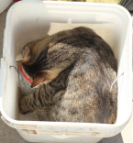

Containerizing an app

Slide 24

Run multiple containers

Slide 25
Orchestrate containers
Run many containers on multiple hosts
Scale - manage several instances (replicas) of the same container
Manage a container based environment

Slide 26
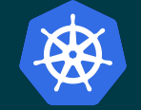

Container orchestration platforms
Kubernetes
OKD (Openshift)

Slide 27
Kubernetes building blocks (some…)
Pod - a group of one or more containers, with shared storage/network
Deployment - manages pod definition and defines replicas of pods
Service - an abstraction, an access point to a set of Pods
Sometimes called a microservice

Slide 28
Microservices - the Kubernetes way
Replica3
Acess point
=
microservice
Code
Replia2
Container
Service A
Pod
Service B
Container
Pod
Repica1

Slide 29
High Complexity

Slide 30
Multiple points of failure
!!!
?

Slide 31
Challenges
How are the requests routed between services?
How do I detect failures and downtime?
How to upgrade and test new versions of a service?
Securing the communication

Slide 32
Service mesh to the rescue

Slide 33
What is a service mesh
Infrastructure/framework that handles communication between services
Often implemented as network proxies deployed alongside the microservices

Slide 34

Istio ... Open source service mesh

Slide 35
The dry facts
Started in May 2017
Means “sail” in Greek
Developed in Go

Slide 36
Istio features
Load balancing (HTTP, gRPC, TCP...)
Traffic control (routing rules, retries, timeouts, fault injection, mirroring)
Secure service-to-service communication
Access controls (authorization)
Metrics and traces for traffic

Slide 37
Important Terminology
Workload - anything owning/controlling pods (like a Deployment) or the pods themselves
Service - a microservice
Application - label “app” on a pod/service
Version - label “version” on a pod/service

Slide 38
Before Istio
POD AP
POD B
Cc
Container
Routing code
Routing code2
Circuit breaker code
Circuit Breaker code2
Business logic code
Business logic code2
Container2
POD A

Slide 39
Istio
POD AP
POD B
Cc
Container
Routing code
Routing code2
Circuit breaker code
Circuit Breaker code2
Business logic code
Business logic code2
Container2
POD A

Slide 40
Istio
A service mesh designed to connect, manage and secure micro services
Open Source

Slide 41
Istio
A service mesh designed to connect, manage and secure micro services
Open Source
Zero Code Changes

Slide 42
FEATURES

Slide 43
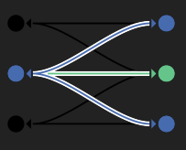
Intelligent Routing And Load Balancing
Conduct traffic between services with dynamic route configuration
A/B tests
Canary releases
Red/Black deployments

Slide 44

Resilience Across Languages And Platforms
Increase reliability by shielding applications from flaky networks and cascading failures in adverse conditions
Provides features like timeouts, retries and circuit breakers

Slide 45
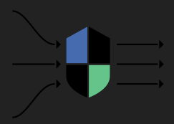
Fleet-wide Policy Enforcement
Apply organizational policy to the interaction between services
Ensure access policies are enforced
Make sure resources are fairly distributed among consumers.
Notes:
Istio allows you to define and enforce policies at the mesh level. You can implement consistent policies for rate limiting, access control, and request routing.

Slide 46
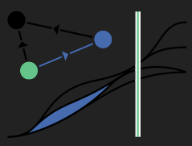
In-depth Telemetry And Reporting
Understand the dependencies between services, the nature and flow of traffic between them, and quickly identify issues with distributed tracing.

Slide 47
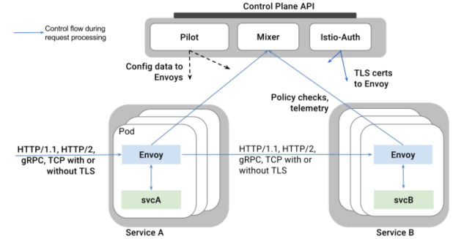
Architecture

Slide 48
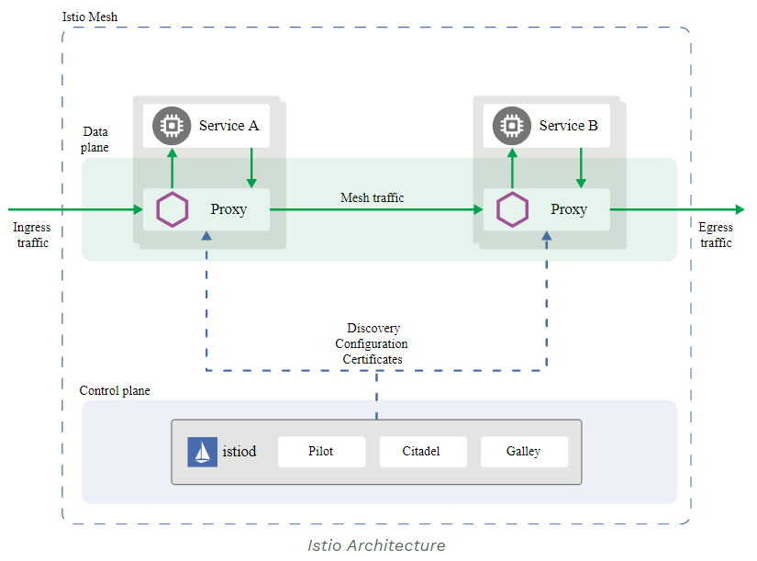
Istio Architecture

Slide 49
Istio Architecture
Istio has two components:
Data plane: The data plane is composed of a set of intelligent proxies (Envoy) deployed as sidecars.
Control plane: The control plane manages and configures the proxies to route traffic.
Notes:
The `data plane` is the communication between services. Without a service mesh, the network doesn’t understand the traffic being sent over, and can’t make any decisions based on what type of traffic it is, or who it is from or to.
Service mesh uses a proxy to intercept all your network traffic, allowing a broad set of application-aware features based on configuration you set.
An `Envoy proxy` is deployed along with each service that you start in your cluster, or runs alongside services running on VMs.
The `control plane` takes your desired configuration, and its view of the services, and dynamically programs the proxy servers, updating them as the rules or the environment changes.

Slide 50

Envoy
An open-source edge and service proxy designed for cloud-native applications.
Envoy proxies are deployed as sidecars to services,
C++ based L4/L7 proxy
Low memory footprint
Battle tested at Lyft
Runs with 100+ services
10K VMs
2M requests/sec

Slide 51
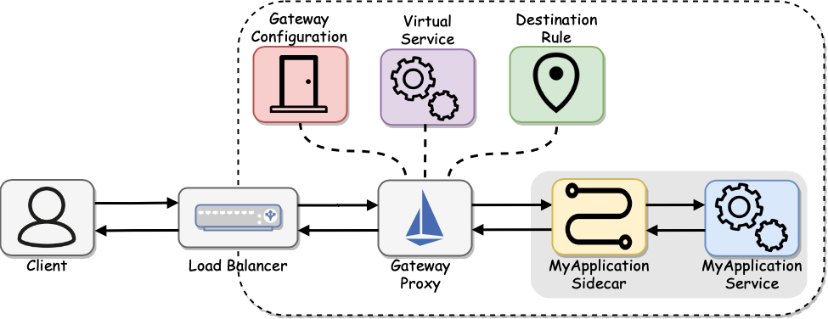
Istio Traffic Management
Istio’s traffic routing rules let you easily control the flow of traffic and API calls between services.
Some of the traffic management API resources,
1. Virtual Services
2. Destination rules
3. Gateways
4. Service entries
5. Sidecars

Slide 52
Virtual Services
A virtual service is a Kubernetes custom resource (CR) that defines traffic routing rules
Key features include,
Traffic Routing
Request Matching
Timeouts and Retires
Load Balancing
TLS Configuration
Retirement and Mirroring
Notes:
Traffic Routing:
Definition: Virtual services define the rules for routing traffic to different destination services.
Example: You can route a percentage of traffic to a new version of a service for canary testing or blue-green deployments.
Request Matching:
Definition: Virtual services allow you to specify criteria for matching incoming requests.
Example: You can match requests based on HTTP headers, paths, or other attributes.
Timeouts and Retries:
Definition: Virtual services let you configure timeouts for requests and specify the number of retries in case of failures.
Example: You can set a timeout for a request and specify that it should be retried if the initial attempt fails.
Fault Injection:
Definition: Virtual services support fault injection for testing the resilience of your services.
Example: You can inject delays or errors into requests to simulate different failure scenarios.
Load Balancing:
Definition: Virtual services allow you to configure load balancing policies for distributing traffic among different service instances.
Example: You can use round-robin or weighted load balancing strategies.
TLS Configuration:
Definition: Virtual services enable you to configure TLS settings for secure communication between services.
Example: You can specify whether to use mutual TLS and configure the required certificates.
Retirement and Mirroring:
Definition: Virtual services support retiring old versions of services and mirroring traffic for testing purposes.
Example: You can gradually shift traffic away from an old version of a service and mirror requests to a new version for monitoring.

Slide 53
How to work with Virtual Services
Define a virtual service
Apply the virtual service
Verify the configuration
Observe Traffic behaviour
Notes:
Define a Virtual Service:
Create a YAML file defining the virtual service, specifying routing rules, timeouts, retries, and other configuration.
Apply the Virtual Service:
Use the kubectl apply command to apply the virtual service configuration to your Kubernetes cluster.
Verify the Configuration:
Use kubectl get virtualservices to verify that the virtual service has been created and is configured correctly.
Observe Traffic Behavior:
Use Istio's observability features, such as Prometheus and Grafana, to observe how traffic behaves according to the virtual service rules.
Iterate and Update:
Modify the virtual service configuration as needed and reapply it to the cluster for dynamic updates to the traffic management rules.

Slide 54
Destination Rules
Destination Rules are another custom resource used for configuring and fine-tuning the behavior of traffic
Used in conjunction with Virtual services
Key features include,
Subnet Definition
Traffic Policies
Connection pool settings
Circuit breaking
TLS Settings
Notes:
Destination Rules are used in conjunction with Virtual Services to define the subset and version-related policies for routing requests to different instances of a service.
Subset Definition:
Definition: Destination Rules allow you to define subsets of a service based on labels.
Example: You can define subsets like "v1" and "v2" based on the version labels of your services.
Traffic Policies:
Definition: Destination Rules enable you to configure traffic policies for each subset, including load balancing and connection pool settings.
Example: You can specify that 80% of traffic should go to "v1" and 20% to "v2" for canary deployments.
Connection Pool Settings:
Definition: Destination Rules allow you to set connection pool settings such as maximum connections, maximum pending requests, etc.
Example: You can limit the number of concurrent connections to each version of a service.
Circuit Breaking:
Definition: Destination Rules support circuit breaking to prevent failures from overwhelming a service.
Example: You can set thresholds for the number of consecutive connection or request failures before a circuit is opened.
TLS Settings:
Definition: Destination Rules enable you to configure TLS settings for secure communication between services.
Example: You can specify whether to use mutual TLS for communication between specific subsets.

Slide 55
Gateways
A gateway custom resource that allows to manage inbound and outbound traffic for your mesh
Key features include,
External service exposure
Host based routing
TLS termination
Load balancing
HTTP and TCP traffic handling
Notes:
External Service Exposure:
Definition: Gateways provide a way to expose services in the service mesh to external networks.
Example: You can use a Gateway to expose an application to the internet or to other networks outside the mesh.
Host-Based Routing:
Definition: Gateways support host-based routing, allowing you to route traffic based on the hostname in the HTTP request.
Example: You can route traffic to different services based on the domain name used in the request.
TLS Termination:
Definition: Gateways can terminate TLS (HTTPS) connections on behalf of services, providing secure communication.
Example: You can configure a Gateway to handle SSL/TLS encryption and decryption for incoming requests.
Load Balancing:
Definition: Gateways can distribute incoming requests to different instances of a service, providing load balancing functionality.
Example: You can use round-robin or weighted load balancing strategies to distribute traffic.
HTTP and TCP Traffic Handling:
Definition: Gateways support both HTTP and TCP traffic, allowing you to handle various types of protocols.
Example: You can configure a Gateway to handle HTTP traffic for web applications or TCP traffic for other services.

Slide 56
Service Entries
A service entry is a Kubernetes custom resource that allows you to add an entry to the service registry that Istio maintains internally
Key Features include,
Defining external service
Custom Hostnames and ports
TLS Configuration
Load Balancing
Health Checking
Notes:
In Istio, a Service Entry is a Kubernetes custom resource that allows you to define external services and endpoints to be accessed by services within the service mesh. Service Entries are used to configure Istio's traffic management for services located outside the mesh, including external services, databases, or APIs. This allows services within the mesh to communicate with external services securely and with Istio features like retries, timeouts, and load balancing.
Defining External Services:
Definition: Service Entries allow you to define external services and their associated endpoints.
Example: You can define a Service Entry for an external API or database.
Custom Hostnames and Ports:
Definition: Service Entries support custom hostnames and ports, providing flexibility in specifying how services are accessed.
Example: You can define a custom hostname and port for an external service.
TLS Configuration:
Definition: Service Entries enable you to configure TLS settings for secure communication with external services.
Example: You can specify whether to use mutual TLS for communication with an external service.
Load Balancing:
Definition: Service Entries allow you to configure load balancing settings for external services.
Example: You can specify load balancing policies when accessing an external service.
Health Checking:
Definition: Service Entries support health checking to determine the health status of external services.
Example: You can configure Istio to perform health checks before directing traffic to an external service.

Slide 57
Sidecar Proxy
A proxy is deployed in a container next to each instance of microservice (inside a pod)
Container name: istio-proxy
It is transparent to application code
Envoy open source proxy is currently used
Key features include,
Proxy Functionality
Service mesh integration
Dynamic configuration
Obsesrvability
Security
Notes:
**Proxy Functionality:**
The sidecar handles incoming and outgoing traffic for the application container, implementing various Istio features.
**Service Mesh Integration:**
The sidecar facilitates communication between microservices within the mesh and participates in the implementation of Istio's control plane functionalities.
**Dynamic Configuration:**
Istio's Pilot component continuously pushes configuration updates to sidecars based on changes in the service mesh.
**Observability:**
Metrics, traces, and logs generated by the sidecar contribute to Istio's observability features.
**Security:**
The sidecar manages encryption and decryption of traffic, implementing Istio's security features.

Slide 58
How is the sidecar injected?
Manually
Automatically injected to pod on creation
kubectl label namespace default istio-injection=enabled
Mutating Admission Webhook is used for sidecar injection
Actually… 2 containers are injected: istio-init and istio-proxy

Slide 59
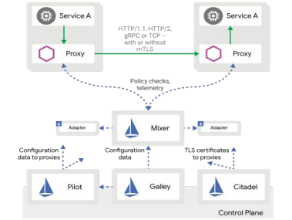
Istio architecture

Slide 60
Sidecar Proxy in Istio and Kubernetes
POD
POD
Container
Side Car Container
Routing code
Circuit breaker code
Container
Business logic code
Business logic code

Slide 61
With Istio - sidecar intercepts all traffic
POD A
POD B
POD C
Container
Container
Container
Business logic code
Business logic code
Business logic code
Sidecar container
Sidecar container
Sidecar container
HTTP, TCP, TLS..
HTTP, TCP, TLS..
Configuration is transparent to the services and not part of the code

Slide 62
Istio routing in Kubernetes
Container
Pod
Sidecar
Container
Container
Service A
Pod
Relica1
Sidecar
Container
Service B
Pod
Relica1
Container
Sidecar
Container
Communication is “Envoy to Envoy”by passing the Kubernetes Service

Slide 63
Different routing scenarios
A/B testing
Traffic shifting
Canary deployment (an example of traffic shifting)
Mirroring traffic

Slide 64
Weighted Routing with Istio - A/B
Pod
Version1
Replica1
Repica2
50%
Traffic
Pod
Service
B
Service
A
50%
Traffic
Pod
Version2
Proportion of traffic routed to a version is
independent of number of instances of that version

Slide 65
Weighted Routing - Canary
Pod
Version1
Replica1
Repica2
90%
Traffic
Pod
Service
B
Service
A
10%
Traffic
Pod
Version2
Proportion of traffic routed to a version is
independent of number of instances of that version

Slide 66
Matching Routing with Istio
All
Users
Pod
Version1
Pod
Service
B
Service
A
User
Alisa
Pod
Version2

Slide 67
Mirroring traffic
Real
Traffic
Pod
Version1
Pod
Service
B
Service
A
Copy
Of Traffic
Pod
Version2
Response
disregarded

Slide 68

"Anything that can go wrong will go wrong“ (Murphy’s law)

Slide 69


Slide 70
Chaos engineering with Istio
Inject delays
Simulate network latency
Simulate an overloaded service
Define aborts (Inject Errors)
Simulate failure in a service (return a predefined HTTP Error)
A good alternative for a manual shutdown or “scale to zero”

Slide 71
Inject delay
Add 7 seconds
delay to
response
Pod
Version1
Instance1
Pod
Service
B
Instance2
Service
A
Pod
Version2

Slide 72
Inject Error
Work as
usual for all
the users
Pod
Version1
Instance1
Pod
Service
B
Instance2
Service
A
Return Error
500 for user
Alissa
Pod
Version2

Slide 73
Circuit breaker
Set a connection pool to limit connections and requests
Example: “Set a connection pool of 100 connections with no more than 10 req/connection to service A”

Slide 74
Outlier detection
Classify instances as healthy/unhealthy
Eject unhealthy instances for a defined timeframe which can be increased over time
Example: “Scan all pods every 5 mins, any instance that fails 7 consecutive times with 5XX error code will be ejected for 15 minutes.”

Slide 75
Authorization and Authentication
Authentication
End user authentication (JSON Web Token (JWT) )
Service to service authentication (mutual TLS)
Permissive mode is possible for flexible migration
Authorization
Can service send to service ?
Roles are visible across namespaces
ServiceRole and ServiceRoleBinding

Slide 76
Security
Defining a Gateway ingress/egress to enable traffic in/out of mesh
Citadel monitors service accounts creation and creates a certificate for them
Certificates only in memory, sent to Envoy via SDS API
mTLS can be defined on multiple levels
Client and server exchange certificates, 2 way
All mesh, specific service, etc.

Slide 77
Configuration objects
Virtual service != Kubernetes service
Rules for how requests to a service are routed within service mesh
Routing logic, load weighting, chaos injection
Destination Rule
Configures policies to be applied to a request after VirtualService routing has occurred
Load balancer, circuit breaker
MeshPolicy, Gateway, ServiceEntry and more...

Slide 78
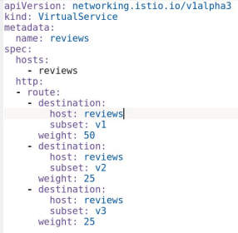
Configuration Yaml example
All Istio objects are
CRD
(CustomResource
Definition)

Slide 79
New set of challenges
How many versions exist for service A?
Is there any traffic now?
Is routing configured for service B?
Is my configuration valid?
Is security on?
Is the app healthy?

Slide 80
Kiali … Open source Istio service mesh observability

Slide 81
Dry facts
Started in January 2018
Means “spyglass” or “monocular” in Greek
Developed in Go and React

Slide 82
Kiali Features
Visualize mesh connections and traffic
Service and application health
Configure routing via UI
Validate Istio configurations
View metrics, traces and logs
Visualize security configuration

Slide 83
A picture is worth a thousand yamls

Slide 84
Demos based on Bookinfo example

Slide 85
Let’s see Kiali in action
Mesh visualization
Fault Injection
Configuration Validation
Configure routing rules
Tracing
Traffic stats

Slide 86
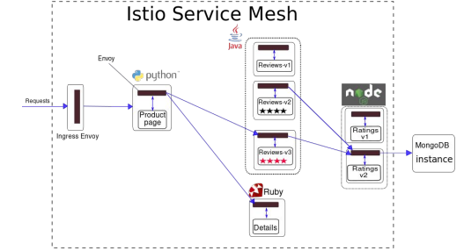
Bookinfo example

Slide 87
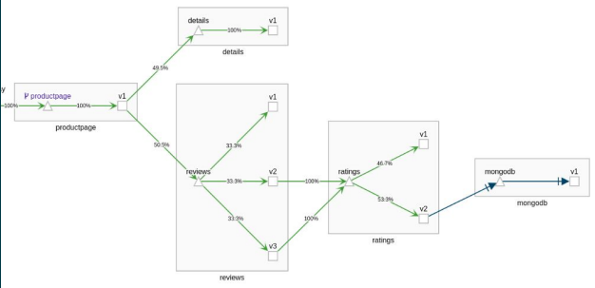
Bookinfo on Kiali

Slide 88
Kiali Features

Slide 89
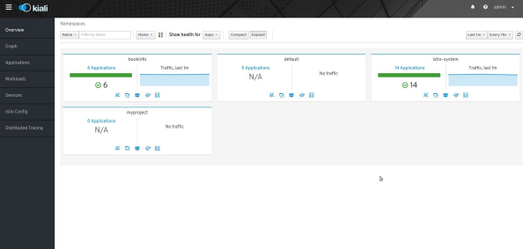
Overview page

Slide 90
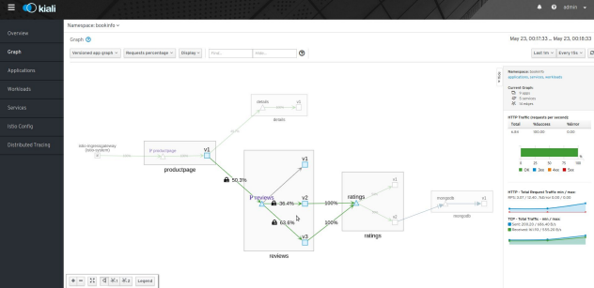
Mesh Topology Graph

Slide 91
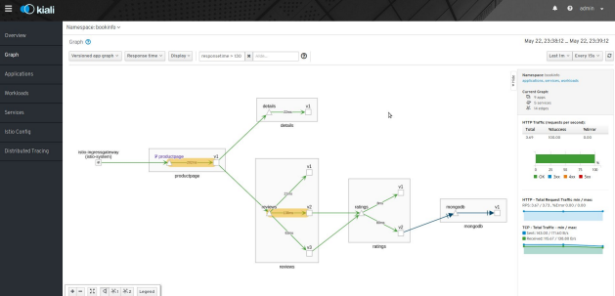
Hide and Seek

Slide 92
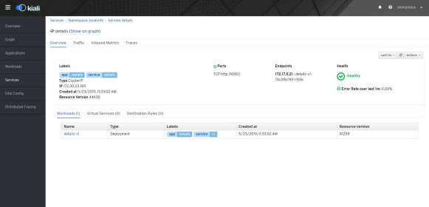
Details Page

Slide 93
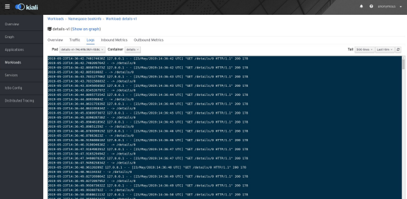
Viewing Logs

Slide 94
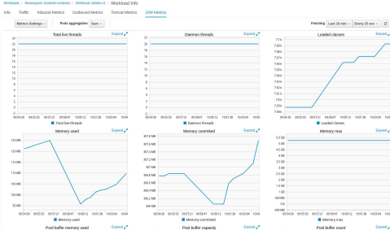
Runtime metric dashboards

Slide 95
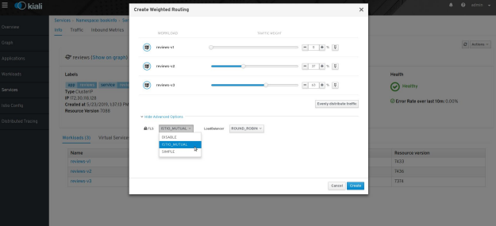
Weighted Routing

Slide 96
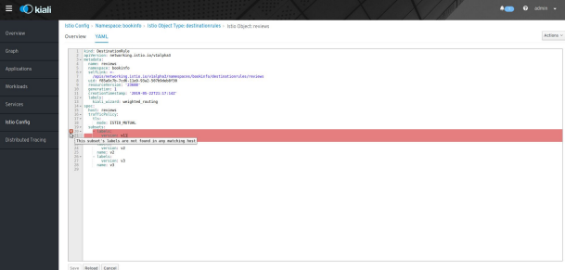
Configuration validations

Slide 97
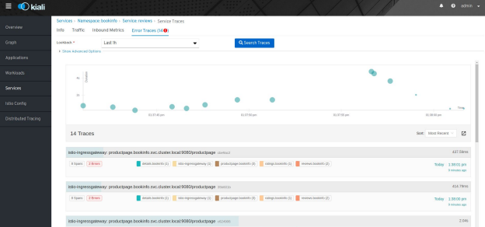
Tracing (integration with Jaeger)

Slide 98
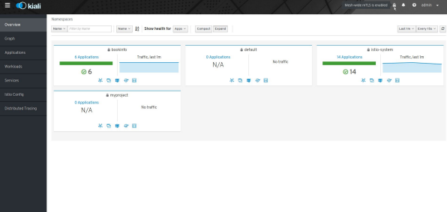
Visualizing security

Slide 99
THANK YOU

